Slide 1
Kavyalakshmi S B.Tech AI&DS
REGNO:821721243029
SINCET

Slide 2
CONVOLUTIONAL NEURAL NETWORK USING IMAGE DETECTION

Slide 3
AGENDA
Problem Definition
Data Collection and Preprocessing
Model Selection
Model Design
Model Training
Model Evaluation
Model Fine-Tuning (Optional):

Slide 4
PROBLEM STATEMENT
Develop a CNN architecture suitable for traffic sign recognition, considering factors such as model complexity, computational efficiency, and accuracy.
Preprocess the dataset, including image resizing, normalization, and augmentation to improve model generalization.
Train the CNN model using the preprocessed dataset, optimizing for high accuracy and robustness in traffic sign detection.
Evaluate the trained model using metrics such as classification accuracy, precision, recall, and F1-score on a separate test dataset.

Slide 5
Project Overview: Traffic Sign Detection and Recognition System
Provide background information on the importance of traffic sign detection and recognition in various applications, such as autonomous vehicles, traffic management systems, and driver assistance technologies.
Explain the objectives of the project and the significance of developing an accurate and reliable convolutional neural network (CNN) for this purpose.

Slide 6
WHO ARE THE END USER?
Autonomous Vehicle Law Enforcement
Agencies Manufacturers
Traffic Management Authorities
Mobile Application Users
Pedestrians and Cyclists

Slide 7
CNN Architecture
Dataset Preparation
Training Procedure
Value Proposition:
Accuracy and Reliability
Real-time Performance
Scalability and Adaptability:

Slide 8
Solution Overview: Convolutional Neural Network (CNN) for Image Detection
Key Components of Our Solution:
Flexible CNN Architecture
Data Preparation and Augmentation
Training Procedure
Evaluation Metrics and Analysis
Deployment and Integration

Slide 9
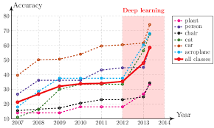
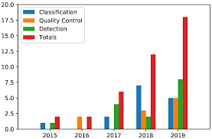
GRAPH

Slide 10
RESULT
Convolutional Neural Networks (CNNs) are widely used in image detection tasks, such as object recognition, face detection, and scene understanding. When trained on a dataset, CNNs learn to extract features from images and use these features to make predictions about the contents of the image.
CLASSIFICATION
Localization
Segmentation
Detection
VISULIZTIONS
DEMO LINK
http://image detection cnn

